Slide 1


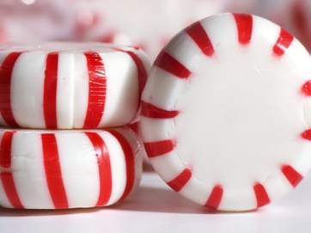

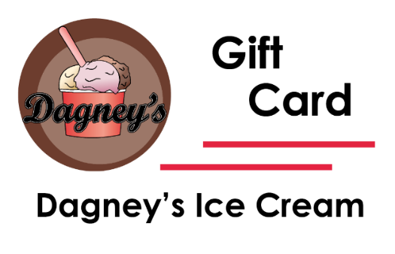
Non-Dairy
Made with a coconut base
Small $7.45
Medium $10.43
Large $13.41
Waffle Cone $10.43
Hand Packed $14.90
Dark Chocolate
Oreo
Strawberry
Coconut
Speculoos
Peppermint
Drinks
BOTTLED WATER - $1.00
SODAS - $3.00
IBC Root Beer
Virgils Root Beer
Dublin Texas Root Beer
Dog-n-Suds Root Beer
Boots Sarsaparilla Root Beer
Dr. Pepper
Coke
Vanilla Cream Soda
Dad’s Blue Cream Soda
Averys Dog Drool
Averys Unicorn Yack
Averys Zombie Brain Juice
Averys Monster Mucus
Averys Gamer Goop
Averys Sour Puss
Ale 8 (Ginger Ale)
Ginger Beer - Reeds
Flying Cauldron Butterscotch Beer
Bawls Guarana Soda
Boylan Ginger Ale
Tart-N-Sweet Lemonade
Dang! Italian Cherry Soda
Dublin Cherry Limeade
Cheerwine (Cherry)
Radioactive Mulberry
Bacon Soda
Bacon with Maple Syrup Soda
Cookie Dough Soda
Pickle Juice
Horchata Soda
Peaches & Cream Soda
Caramel Apple Soda
Orange Dromsicle
Float - $8.94
2 scoops any ice cream
Plus your choice of Soda.
Float with Ramuné + $2.00
Ramuné $5.50
Lychee
Strawberry
Orange
Grape
CHECK US OUT ON FACEBOOK
Flavors updated on our page regularly ☺

